Slide 1
LINECO Limpopo North East Conference
VISION CASTING 2012/15

Slide 2
Presenter: Bishop MW Lalamani Date: 21/01/2012

Slide 3
INTRODUCTORY REMARKS
Proverbs 18:9 [Amplified Version]
He who is loose and slack in his work is brother to him who is a destroyer and he who does not use his endeavors to heal himself is brother to him who commits suicide.
Loose – Relaxed; Not strict or exact; careless
Slack – not held tightly into position; not busy; quiet; lazy; negligent

Slide 4
BE CAREFUL: 2013
Eph 5:15 So be very careful how you live. Live wisely, not like fools.
Eph 5:16 I mean that you should use every opportunity you have for doing good, because these are evil times. [Easy To Read Version]

Slide 5
VISION
KINGDOM EXTENSION
MISSION
MATURING BELIEVERS CAUSING GENERAL CHURCH GROWTH

Slide 6
OBJECTIVES
Well- Equipped Harvesters/Labourers
Vibrant Children’s Church
Vibrant Youth Ministries
Intensive Word Study
Impacting Worship
Healthy Church Financial Backing

Slide 7
STRATERGIES
Well Coordinated Bible School Trainings Addressing:
Pastoral Vacancies
Children’ Church Teachings
Youth Ministries Pastorate
Word Study Teachings
Worship Leadership
Evangelical Business
Vigorous Constitutional Orientation
Monthly Systematic Pastoral Reporting
Monthly Systematic Administrative Report
Monthly Systematic Ministerial Reports

Slide 8
Remember your Conference Leadership and give Support
Conference Board Members:
Conference Superintendent: Bishop MW Lalamani
Missions Director - Deputy Conference Superintendent: Reverend MS Mathivha
Administrator: Reverend KP Mulelu
CEM Director: Reverend MJ Chuma
Evangelism Director: Reverend S Mametsa
Women’s Ministries President: Pastor VF Mmethi
Men’s Ministries Director: Mr ME Mudau
WIN Director: Mrs EN Mukwevho

Slide 9
ISSUES FOR DISCUSSION
Site For Conference Centre
2013 LINECO Annual Conference
Centennial Celebration Preparations
Venue
Date: 26 - 30/06/2013
National Centennial Celebration Issues:
Additional R2 000.00
Pledges
Registrations, Transport and Lodging

Slide 10
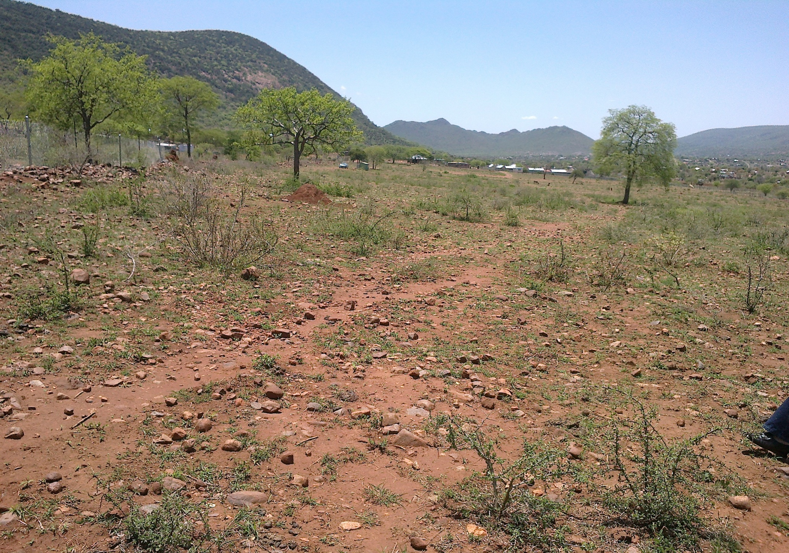
Maname Paradise: 5 Hectars

Slide 11
Visit on 03/11/2013

Slide 12
THE END Lets Gear Ourselves Up to Celebrate Our Centenary in Style: Win Souls For Christ!!!

